Slide 1
Types of Monoliths
Pravin Y Pawar

Slide 2
Monolith
The unit of deployment
When all the functionality in a system had to be deployed together
Three types
Single process monolith
Distributed monolith
Third party black-box systems

Slide 3
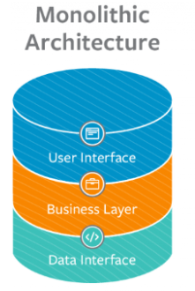
Single Process Monolith
Most common example is system where all of the code is deployed as a single process
May have multiple instances of this process for robustness or scaling
Fundamentally all code is wrapped into one process
In reality, these are simple distributed system
They nearly end up reading data from or storing data into database
source

Slide 4
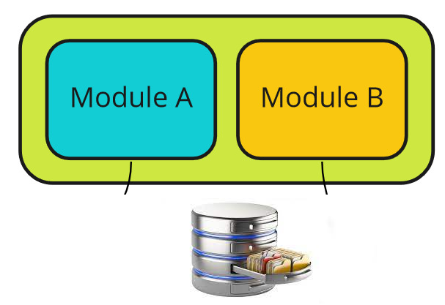
Modular monolith
Subset of single process monolith
Single process consists of separate modules, each of which can be worked on independently
But still need to be combined for deployment
If module boundaries are well defined
allows high degree of parallel working
Sidesteps challenges of distributed architecture
Provides much simpler deployments

Slide 5
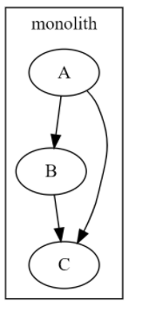
Distributed monolith
A distributed system is one in which failure of computer you didn’t even know existed can render your own computer unusable. – Leslie Lamport
System consisting of multiple services but for whatever reasons needs to be deployed together
May meet definition of Service Oriented Architecture (SOA)
Have disadvantages of both single process monoliths and distributed systems

Slide 6

Third party black-box systems
Third party systems like payroll systems, CRM systems, HR systems
Common factors
Software developed by other people
Don’t have control on the change of code or deployment
Examples
Can be off-the-shelf software deployed on own infrastructure
Can be Software-as-a-Service (SaaS) product being used
Integration is the key here!
source

Slide 7
Thank You!
Source :
Monolith to Microservices by Sam Newman
In our next session:

